Slide 1
Time Complexity in Algorithms
Zachary Zenner

Slide 2
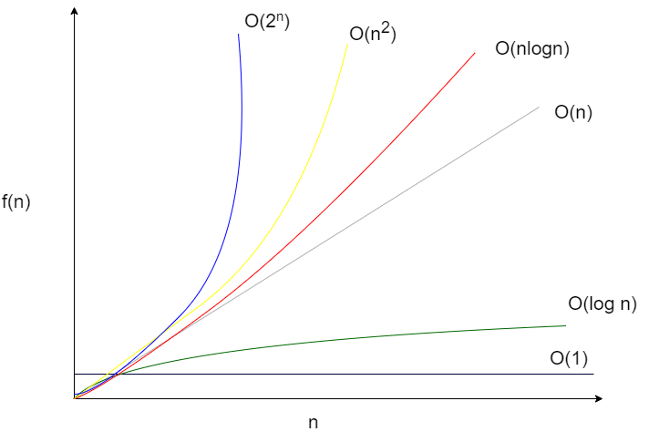
What is Time Complexity?

Slide 3
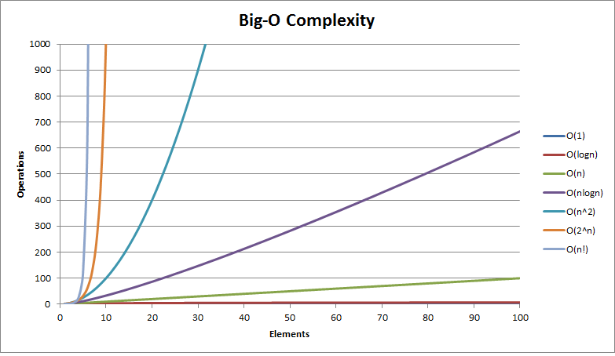
The Different ways to describe each time complexity (fastest to slowest)
0(1) - Constant Complexity
0(log n) - Logarithmic Complexity
0(n) - Linear Complexity
0(nlog n) - Linearithmic Complexity
0(n²) - Quadratic Complexity
0(2^{n}) - Exponential Complexity
0(n!) - Factorial Complexity

Slide 4
Applications
Help programmers quickly share their algorithms
Concrete description of the speed
Optimize programs and systems

